Slide 1
Chapter 6: Project Schedule Management
Information Technology Project Management, Ninth Edition
Note: See the text itself for full citations

Slide 2
Learning Objectives (1 of 2)
Illustrate the importance that project schedules and good project schedule management can have in helping to make projects successful
Discuss the process of planning schedule management
Define activities as the basis for developing project schedules
Describe how project managers use network diagrams and dependencies to assist in activity sequencing
Explain how various tools and techniques help project managers perform activity duration estimates
Use a Gantt chart for planning and tracking schedule information, find the critical path for a project, and describe how critical chain scheduling and the Program Evaluation and Review Technique (PERT) affect schedule development

Slide 3
Learning Objectives (2 of 2)
Compare how schedule management is addressed using Agile vs. more predictive project approaches
Discuss how reality checks and discipline are involved in controlling and managing changes to the project schedule
Describe how project management software can assist in project schedule management and review words of caution before using this software
Discuss considerations for agile/adaptive environments

Slide 4
The Importance of Project Schedules (1 of 3)
Managers often cite delivering projects on time as one of their biggest challenges
Time has the least amount of flexibility; it passes no matter what happens on a project
Individual work styles and cultural differences may also cause schedule conflicts
Different cultures and even entire countries have different attitudes about schedules

Slide 5
Project time management processes
Planning schedule management
Defining activities
Sequencing activities
Estimating activity resources
Estimating activity durations
Developing the schedule
Controlling the schedule

Slide 6
Project Time Management Processes
Planning schedule management: determining the policies, procedures, and documentation that will be used for planning, executing, and controlling the project schedule
Defining activities: identifying the specific activities that the project team members and stakeholders must perform to produce the project deliverables
Sequencing activities: identifying and documenting the relationships between project activities
Estimating activity resources: estimating how many resources a project team should use to perform project activities
Estimating activity durations: estimating the number of work periods that are needed to complete individual activities
Developing the schedule: analyzing activity sequences, activity resource estimates, and activity duration estimates to create the project schedule
Controlling the schedule: controlling and managing changes to the project schedule
Notes:
Six processes How Do We Manage Time?Define Activities
Sequence Activities
Estimate Activity Resources
Estimate Activity Durations
Develop Schedule
Control Schedule

Slide 7
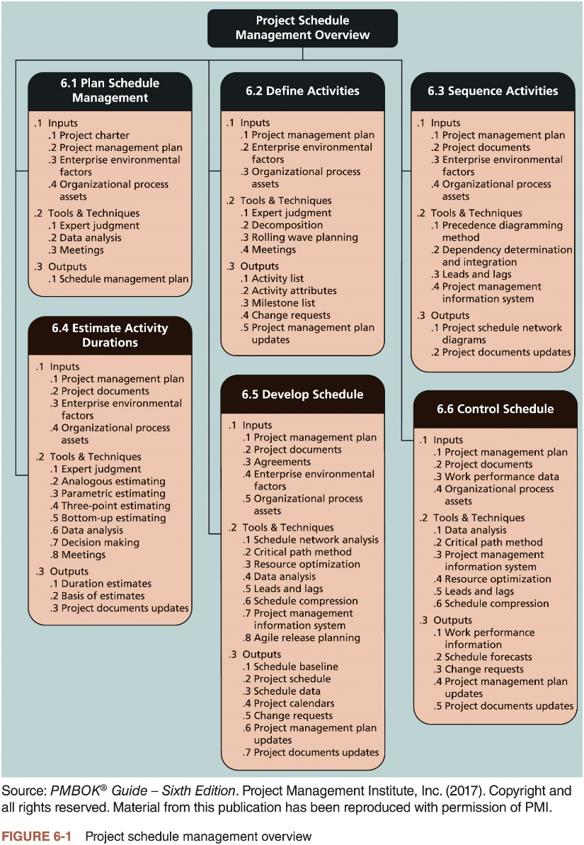
The Importance of Project Schedules (3 of 3)

Slide 8
Planning Schedule Management
How schedule will be managed and developed? (follow the life cycle of the project)
Basic doc/charter, start-end dates, detail schedule, envir. factors, assets, experts judgment, analytical techniques, meetings, etc.
Elements of a schedule management plan
Project schedule model development
Project activities, estimated durations, dependencies, (Microsoft project model)
Scheduling methodology
Level of accuracy and units of measure
How accurate is your schedule (hours, days, other units)
Control thresholds Variance threshold +-10% schedule
Rules of performance measurement % of work completed
Reporting formats format & frequencies of schedule reports
Process descriptions How all of the schedule manag. Processes will be performed.

Slide 9
Defining Activities (1 of 2)
Defining activities involves identifying the specific actions that will produce the project deliverables in enough detail to determine resource and schedule estimates
Activity list: a tabulation of activities to be included on a project schedule
An activity or task is an element of work normally found on the work breakdown structure (WBS) that has an expected duration, a cost, and resource requirements
Activity List includeS
Activity name, activity identifier or number, and brief description of the activity
identify specific actions, details of the schedule +resource, strong scope definition good information concerning cost, quality, human resources, and
Activity attributes provide more information
Predecessors, successors, logical relationships, leads and lags, resource requirements, constraints, imposed dates, and assumptions related to the activity
Notes:
Decomposition
Templates
Rolling wave planning (Progressive planning, wbs)
Expert judgment
Planning component
Input: Work Breakdown Structure, Project Management Plan, WBS dict, Proj Scope Statement
Output!

Slide 10
Defining Activities (2 of 2) Activity Lists, Attributes, Milestones
A milestone is a significant event that normally has no duration
It often takes several activities and a lot of work to complete a milestone
They’re useful tools for setting schedule goals and monitoring progress
Examples: obtaining customer sign-off on key documents or completion of specific products
It often takes several activities and a lot of work to complete a milestone

Slide 11
Project Project time management processesTime Management
Planning schedule management
Defining activities
Sequencing activities
Estimating activity resources
Estimating activity durations
Developing the schedule
Controlling the schedule

Slide 12
Sequencing Activities (1 of 6) After you define activities move to the sequencing of activities and their dependencies (task4 should be done in || with task12, and before task6)
Sequencing process involves evaluating the reasons for dependencies and the different types of dependencies
A dependency or relationship is the sequencing of project activities or tasks Three types of Dependencies
Mandatory dependencies:{ inherent in the nature of the work being performed on a project, sometimes referred to as hard logic (logic (Start testing only after writing the code)
Discretionary dependencies: defined by the project team, sometimes referred to as soft logic. and should be used with care since they may limit later scheduling options Good practice. Do not start the design until the user(s) sign on on all the analysis)
External dependencies: involve relationships between project and non-project activities activities (new OS needs a new hardware)

Slide 13
Several techniques to perform activity sequencing
Schematic diagrams and graphical display
Show the logical relationship among activities
Refer to as PERT charts (Project Schedule Net Diagram)

Slide 14
Sequencing Activities (2 of 6) Network diagrams
Network diagrams are the preferred technique for showing activity sequencing
A network diagram is a schematic display of the logical relationships among, or sequencing of, project activities
Two main formats are the arrow and precedence diagramming methods:
arrow diagramming method (ADM)
precedence diagramming method (PDM)

Slide 15
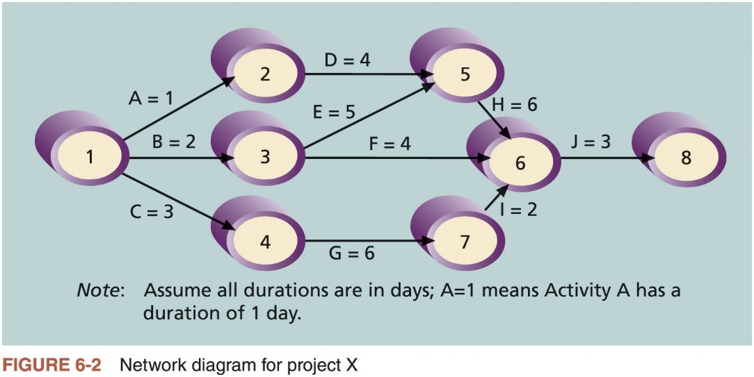
Sequencing Activities (3 of 6)

Slide 16
Sequencing Activities (4 of 6)
Arrow diagramming method (ADM) (i.e., activity-on-arrow (AOA) network diagrams)
Activities are represented by arrows
Nodes or circles are the starting and ending points of activities
Only show finish-to-start dependencies
Refer to the text for the step-by-step process of creating AOA diagrams
Precedence diagramming method (PDM)
Activities are represented by boxes
Arrows show relationships between activities
Network diagramming technique in which boxes represent activities
Types of dependencies or relationships between activities
Finish-to-start
Start-to-start
Finish-to-finish
Start-to-finish

Slide 17
Method Comparison
PDM Method
Build Foundation
Build Walls
Build Roof
Finish
Start
Install Grass
ADM (Method
Build Foundation
Build Walls
Build Roof
Start
Finish
Install Grass

Slide 18
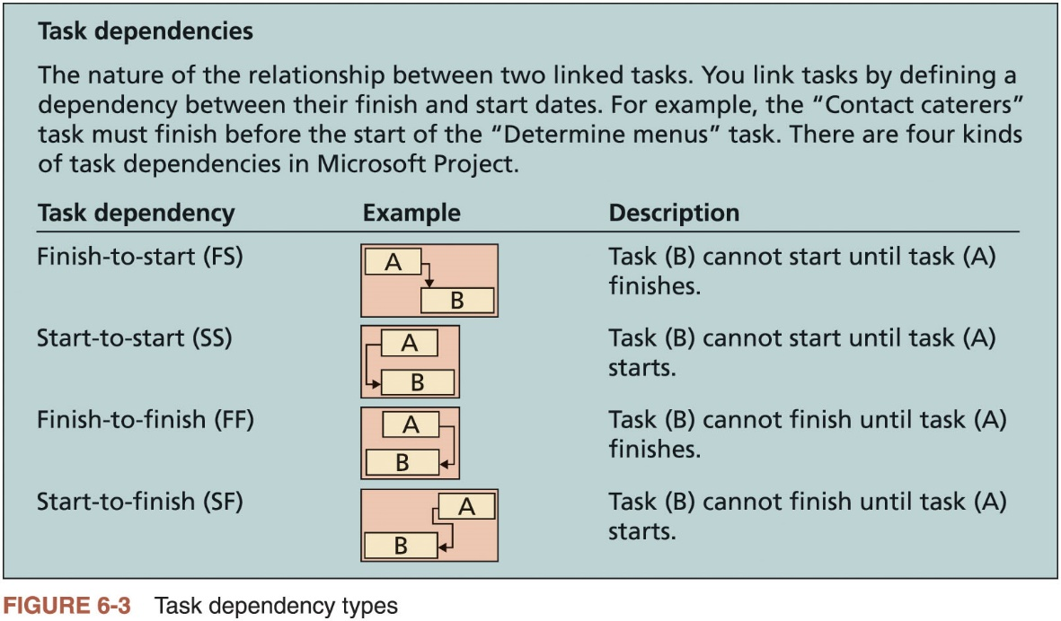
Sequencing Activities (5 of 6)

Slide 19
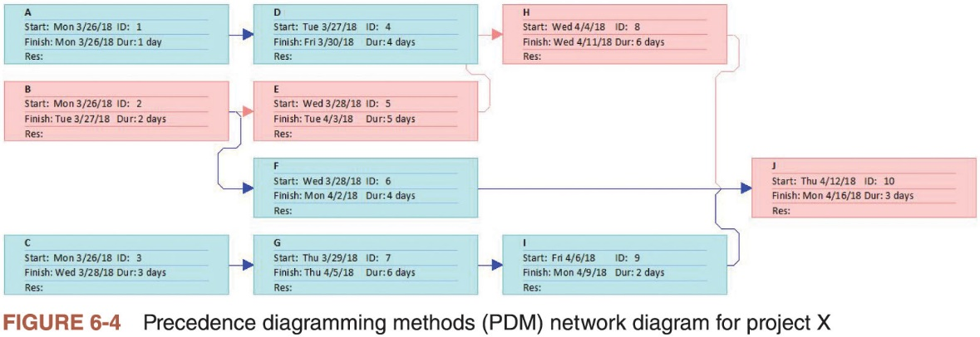
Sequencing Activities (6 of 6) (PDM)

Slide 20
Project Time Management Processes
Planning schedule management
Defining activities
Sequencing activities
Estimating activity resources
Estimating activity durations
Developing the schedule
Controlling the schedule

Slide 21
Project Time Management Processes
Planning schedule management: determining the policies, procedures, and documentation that will be used for planning, executing, and controlling the project schedule
Defining activities: identifying the specific activities that the project team members and stakeholders must perform to produce the project deliverables
Sequencing activities: identifying and documenting the relationships between project activities
Estimating activity resources: estimating how many resources a project team should use to perform project activities
Estimating activity durations: estimating the number of work periods that are needed to complete individual activities
Developing the schedule: analyzing activity sequences, activity resource estimates, and activity duration estimates to create the project schedule
Controlling the schedule: controlling and managing changes to the project schedule

Slide 22
Estimating Activity Durations
Duration includes the actual amount of time worked on an activity plus elapsed time
Effort is the number of workdays or work hours required to complete a task and does not normally equal duration
People doing the work should help create estimates
An expert should review them
A three-point estimate is an estimate that includes an optimistic, most likely, and pessimistic estimate
Three-point estimates are needed for PERT and Monte Carlo simulations

Slide 23
Developing the Schedule
Uses results of the other time management processes to determine the start and end date of the project
Ultimate goal is to create a realistic project schedule that provides a basis for monitoring project progress for the time dimension of the project
People doing the work should help create estimates, and an expert should review them
Important tools and techniques for developing the schedule
Gantt charts
Critical path analysis
Critical chain scheduling
PERT analysis

Slide 24
Gantt Charts (1 of 5)
Provide a standard format for displaying project schedule information by listing project activities and corresponding start and finish dates in a calendar form
Symbols used
Black diamond: milestones :
Milestones emphasize important events or accomplishments on projects
Thick black bars: summary tasks
Light gray horizontal bars: durations of tasks
Arrows: dependencies between tasks

Slide 25
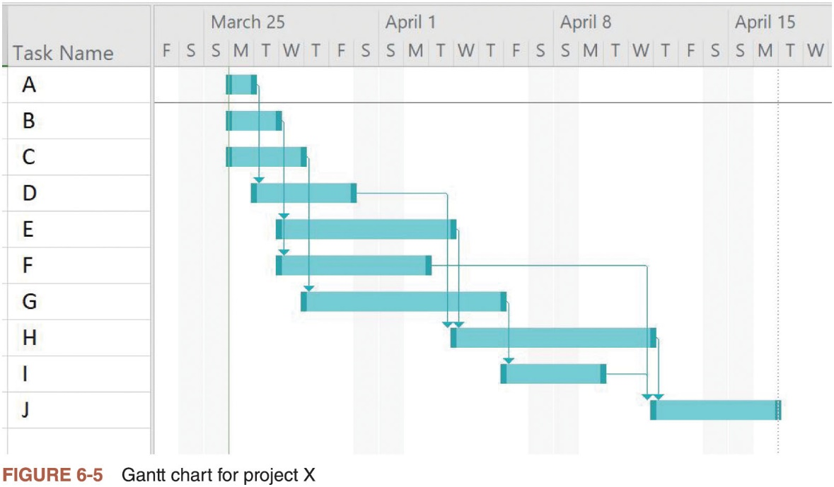
Gantt Charts (2 of 5)

Slide 26
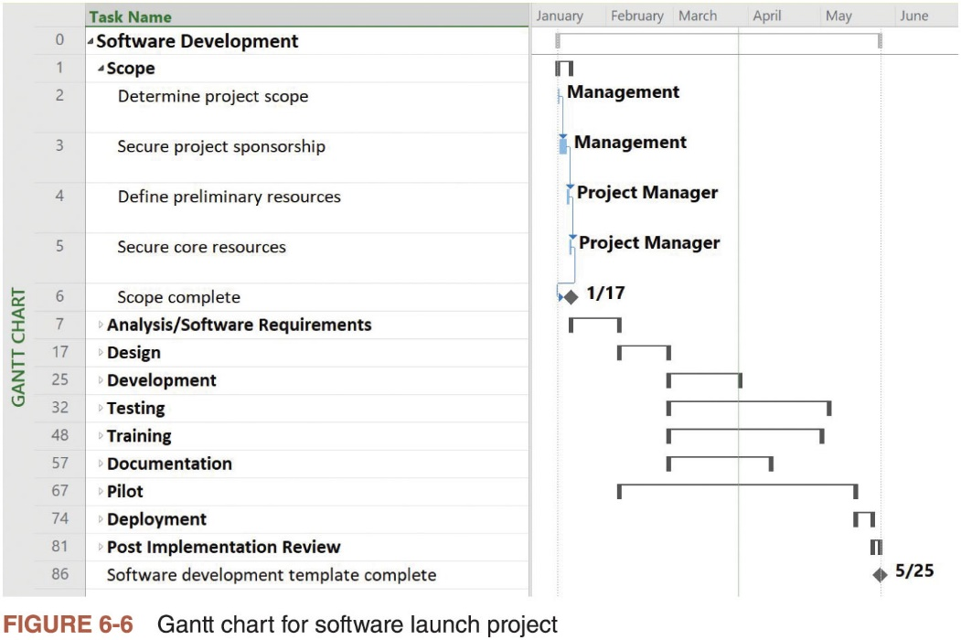
Gantt Charts (3 of 5)

Slide 27
Gantt Charts (4 of 5)
Adding milestones to Gantt charts
Many people like to focus on meeting milestones, especially for large projects
Milestones emphasize important events or accomplishments on projects
SMART Criteria for milestones
Specific
Measurable
Assignable
Realistic
Time-framed

Slide 28
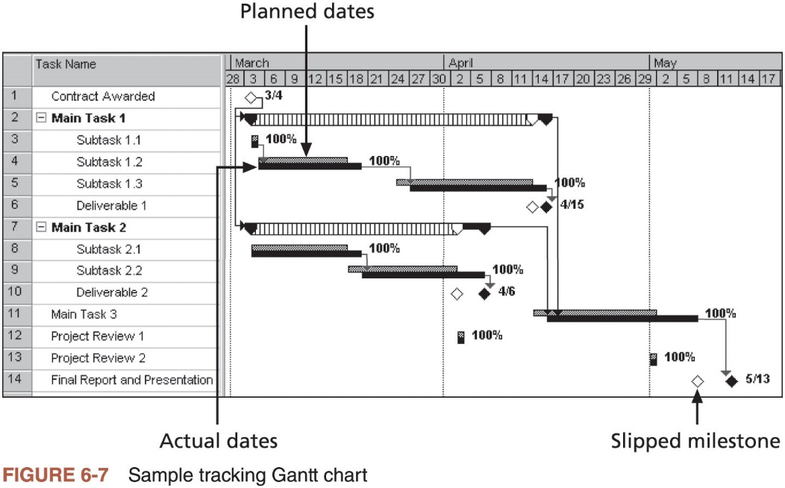
Gantt Charts (5 of 5)

Slide 29
Critical Path Method (CPM) (1 of 2)
Network diagramming technique used to predict total project duration
Critical path: series of activities that determine the earliest time by which the project can be completed
The longest path through the network diagram and has the least amount of slack or float; amount of time an activity may be delayed without delaying a succeeding activity or the project finish date
The critical path is the longest path through the network diagram and has the least amount of slack or float
Slack or float is the amount of time an activity may be delayed without delaying a succeeding activity or the project finish date
Calculating the critical path
Develop a good network diagram and add the duration estimates for all activities on each path through the network diagram
Longest path is the critical path
If one or more of the activities on the critical path takes longer than planned, the whole project schedule will slip unless the project manager takes corrective action

Slide 30
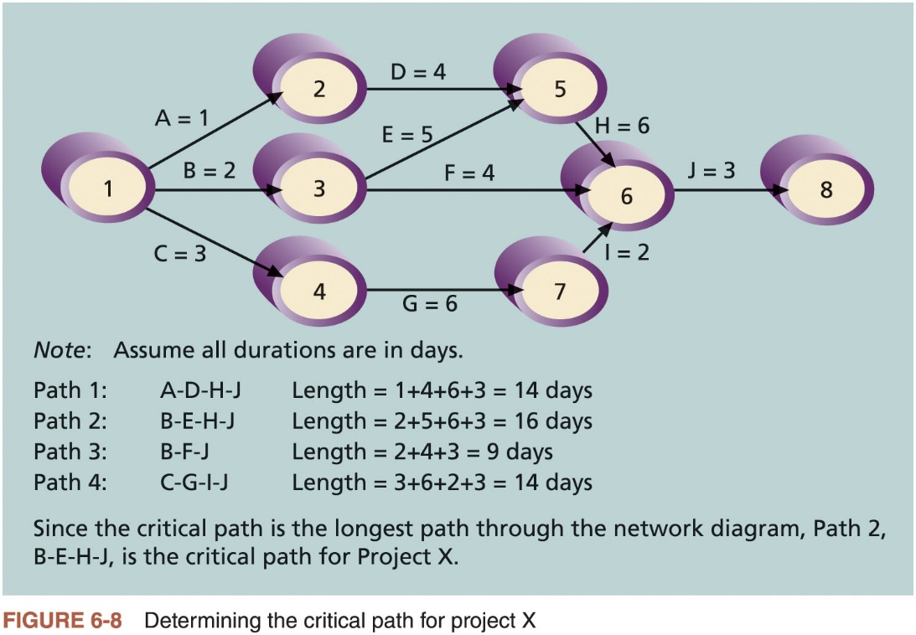
Critical Path Method (CPM) (2 of 2)

Slide 31
Growing Grass Can Be on the Critical Path
The fact that its name includes the word critical does not mean that it includes all critical activities
Only accounts for time
Example: growing grass for Disney’s Animal Kingdom
There can be more than one critical path if the lengths of two or more paths are the same
Project managers should closely monitor performance of activities on the critical path to avoid late project completion
Critical path can change as the project progresses

Slide 32
Using Critical Path Analysis to Make Schedule Trade-Offs
Free slack or free float
Amount of time an activity can be delayed without delaying the early start of any immediately following activities
Total slack or total float
Amount of time an activity may be delayed from its early start without delaying the planned project finish date
Forward pass
Determines the early start and finish dates
Backward pass
Determines the late start and finish dates

Slide 33
Scheduling from Estimates
Critical Path
Longest time through the network diagram, the shortest time the project is expected to take
Slack (or Float)
The amount of time a task can be delayed without impacting the project
Calculated using:
Late Start – Early Start (LS-ES)
Or
Late Finish – Early Finish (LF-EF)
Early Starts computed by making a “forward pass” through the network while late starts are computed using a “backward pass”

Slide 34
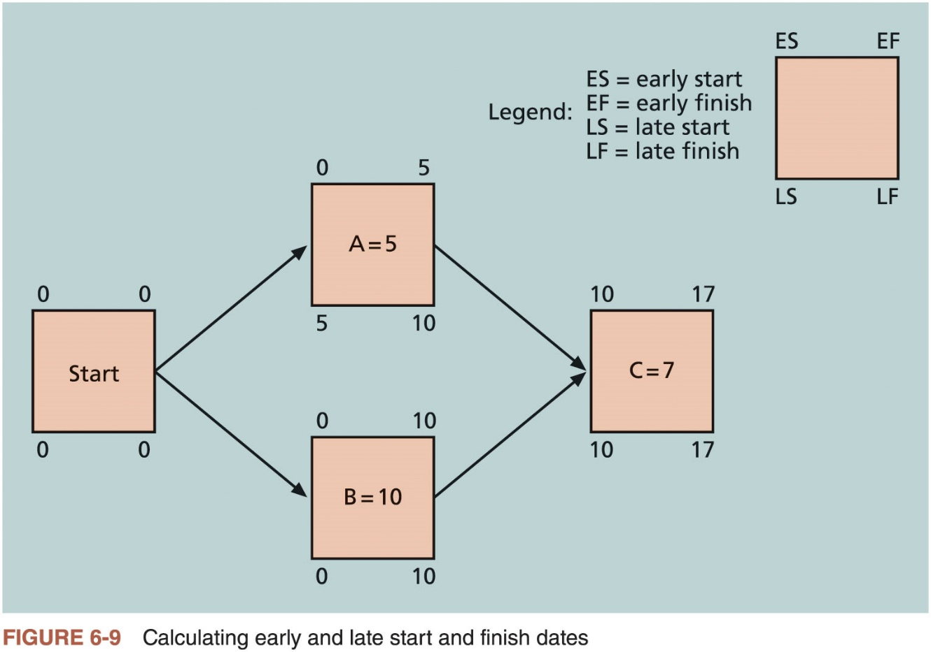
Using Critical Path Analysis to Make Schedule Trade-Offs

Slide 35
Using Critical Path Analysis to Make Schedule Trade-Offs (3 of 3)
Task Name | Start | Finish | Late Start | Late Finish | Free Slack | Total Slack
A | 8/3/15 | 8/3/15 | 8/5/15 | 8/5/15 | 0d | 2d
B | 8/3/15 | 8/4/15 | 8/3/15 | 8/4/15 | 0d | 0d
C | 8/3/15 | 8/5/15 | 8/5/15 | 8/7/15 | 0d | 2d
D | 8/4/15 | 8/7/15 | 8/6/15 | 8/11/15 | 2d | 2d
E | 8/5/15 | 8/11/15 | 8/5/15 | 8/11/15 | 0d | 0d
F | 8/5/15 | 8/10/15 | 8/14/15 | 8/17/15 | 7d | 7d
G | 8/6/15 | 8/13/15 | 8/10/15 | 8/17/15 | 0d | 2d
H | 8/12/15 | 8/19/15 | 8/12/15 | 8/19/15 | 0d | 0d
I | 8/14/15 | 8/17/15 | 8/18/15 | 8/19/15 | 2d | 2d
J | 8/20/15 | 8/24/15 | 8/20/15 | 8/24/15 | 0d | 0d
Table 6-1 Free and Total Float or Slack for Project X

Slide 36
Using the Critical Path to Shorten a Project Schedule
Main techniques for shortening schedules
Shortening durations of critical activities/tasks by adding more resources or changing their scope
Crashing activities by obtaining the greatest amount of schedule compression for the least incremental cost
Fast tracking activities by doing them in parallel or overlapping them

Slide 37
Importance of Updating Critical Path Data
It is important to update the schedule with actual data
Note actual activity durations as they are completed
Revise estimates for activities in progress
Monitor changes to make informed decisions

Slide 38
Critical Chain Scheduling (1 of 4)
Considers limited resources when creating a project schedule and includes buffers to protect the project completion date
Uses the Theory of Constraints (TOC): management philosophy developed by Eliyahu M. Goldratt; attempts to minimize multitasking when a resource works on more than one task at a time

Slide 39
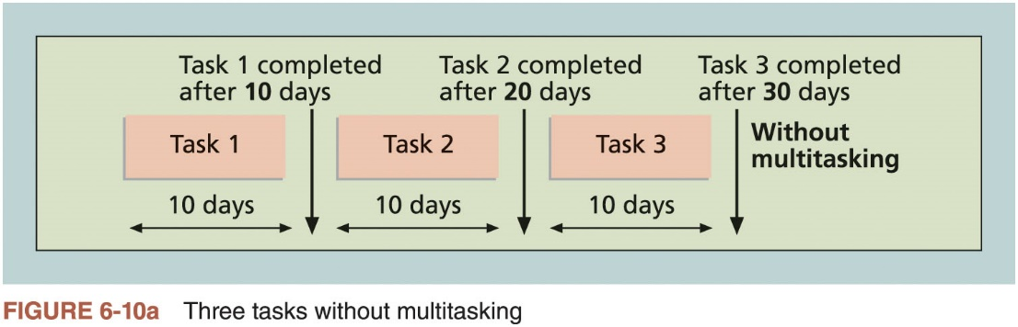
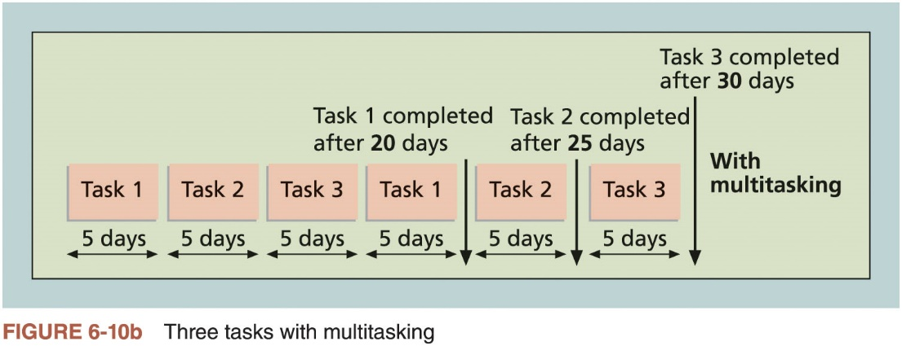
Critical Chain Scheduling (2 of 4)

Slide 40
Critical Chain Scheduling (3 of 4)
Additional concepts
Buffer: additional time to complete a task
Murphy’s Law: if something can go wrong, it will
Parkinson’s Law: work expands to fill the time allowed
Project buffer: additional time added before the project’s due date
Feeding buffers: additional time added before tasks on the critical path

Slide 41
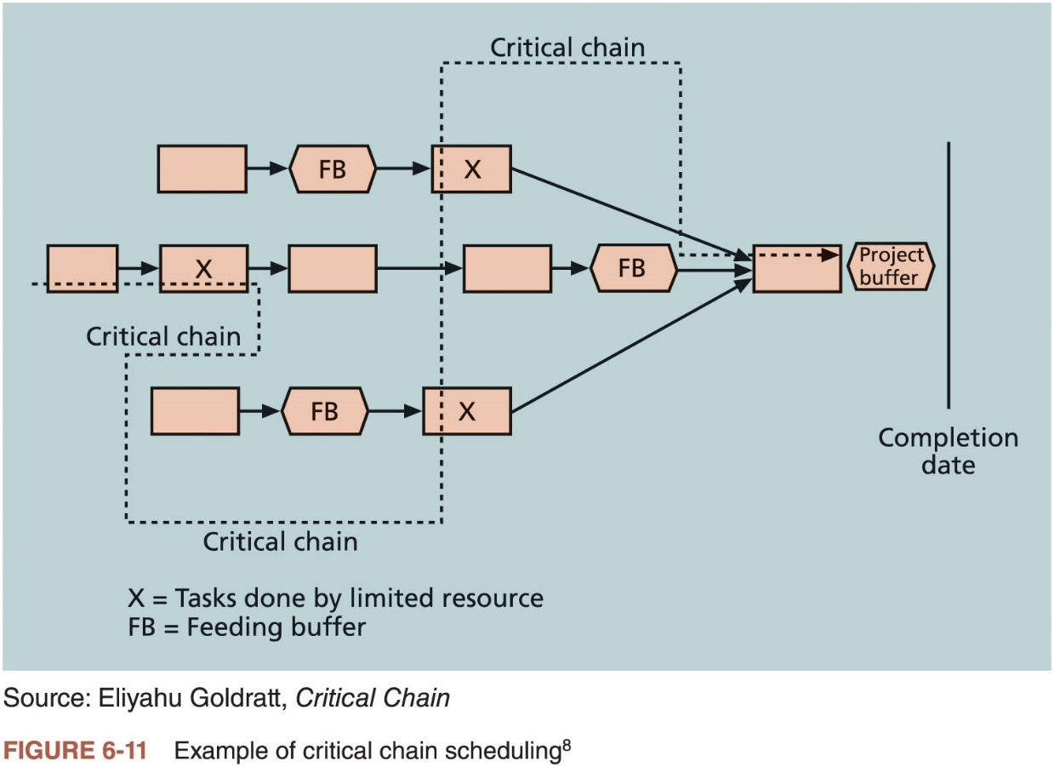
Critical Chain Scheduling (4 of 4)

Slide 42
Program Evaluation and Review Technique (PERT)
Network analysis technique used to estimate project duration when there is a high degree of uncertainty about the individual activity duration estimates
Uses probabilistic time estimates: duration estimates based on using optimistic, most likely, and pessimistic estimates of activity durations
By using the PERT weighted average for each activity duration estimate, total project duration estimate takes into account the risk or uncertainty in the individual activity estimates

Slide 43
Agile and Schedule Management
Core values of the Manifesto for Agile Software Development
Customer collaboration over contract negotiation
Responding to change over following a plan
Example: product owner defines and prioritizes the work to be done within a sprint
Collaboration and time management are designed into the process

Slide 44
Controlling the Schedule
Goals of schedule control
Know the status of the schedule
Influence the factors that cause schedule changes
Determine that the schedule has changed
Manage changes when they occur
Main inputs to schedule control
Project management plan
Project documents
Work performance data
Organizational process assets

Slide 45
Reality Checks on Scheduling and the Need for Discipline
Important activities
Review the draft schedule or estimated completion date in the project charter
Prepare a more detailed schedule with the project team
Make sure the schedule is realistic and followed
Alert top management well in advance if there are schedule problems

Slide 46
Using Software to Assist in Project Schedule Management
Software for facilitating communications helps people exchange schedule-related information
Decision support models help analyze trade-offs that can be made to address schedule issues
Project management software can help in various time management areas

Slide 47
Global Issues
Microsoft tells the customer story of Mexico’s Secretary of Economy, who wanted to ensure that IT initiatives aligned with business goals and improved project management efficiency
After implementing new software, their IT team could handle four times the number of concurrent projects without adding more staff

Slide 48
Words of Caution on Using Project Management Software
Many people misuse project management software because they don’t understand important concepts and have not had training
Example: dependencies must be entered to have dates adjust automatically and to determine the critical path
Many project management software programs come with templates or sample files
It is very easy to use these files without considering unique project needs
Project managers and their teams should be careful not to rely too much on templates or sample files and ignore the unique concerns of their particular projects

Slide 49
Considerations for Agile/Adaptive Environments
Schedule management is radically different using Agile and Scrum
Projects that rely heavily on the critical path method consider meeting the project’s estimated completion date as a crucial component of success
Agile projects may not even need to estimate activity durations or project schedules at all; overall project completion time is not important

Slide 50
Chapter Summary
Project time management is often cited as the main source of conflict on projects
Most IT projects exceed time estimates
Main processes
Plan schedule management
Define activities
Sequence activities
Estimate activity resources
Estimate activity durations
Develop schedule
Control schedule

